Slide 1



Tensor-Based Multi-Modal Multi-Target Regression for Alzheimer’s Disease Prediction
Jun Yu, Benjamin Zalatan, Yong Chen, Li Shen, and Lifang He
Speaker: Jun Yu
Date: December 6, 2022

Slide 2
Outline
Background
Related Work
Method
Experiment
Conclusion

Slide 3
Outline
Background
Related Work
Method
Experiment
Conclusion

Slide 4
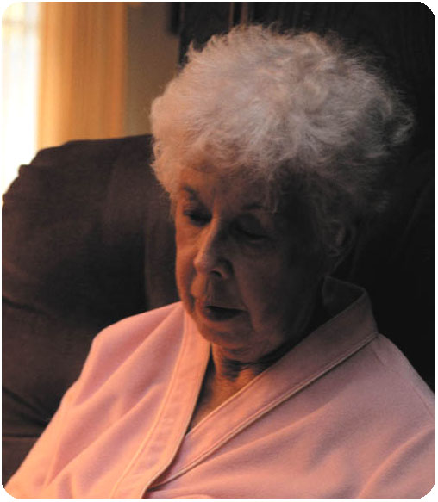
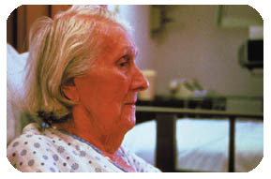
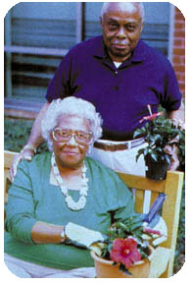
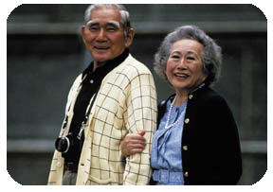
What is Alzheimer’s Disease?
Alzheimer’s Disease (AD) is one of the most common and incurable neurodegenerative diseases, which can result in progressive cognitive decline and behavioral impairment, and even cause death in severe cases.
Notes:
Forget relatives
Physical functioning
Close to our life
Abnormal aging process

Slide 5
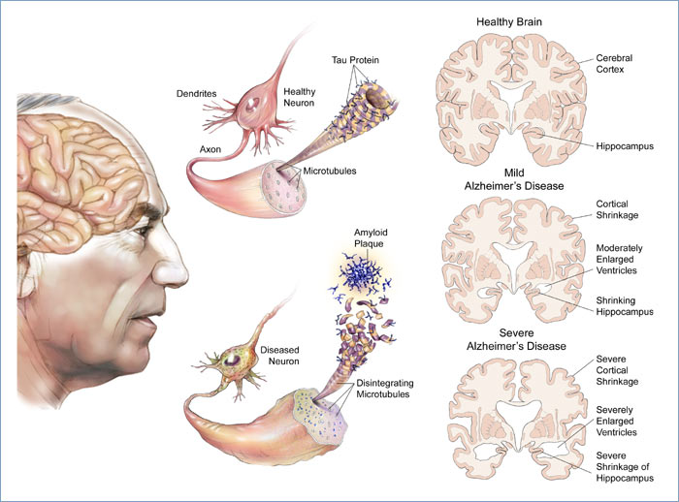
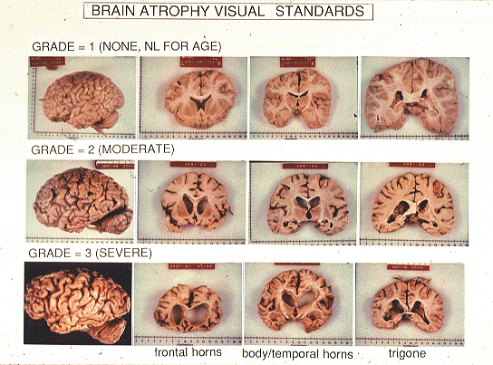
Physical Changes in Brain
Degradation from cell to organ:
Notes:
Cavity
microtubules

Slide 6
Five Stages of AD
Normal Controls (CN)
Significant memory concern (SMC)
Early Mild Cognitive Impairment (EMCI)
Late Mild Cognitive Impairment (LMCI)
AD Patients (AD)

Slide 7
Statistics of AD in U.S.
5,000,000+ detected.
20,000,000+ affected.
1 AD developed per minute.
6th cause of death (4.23%).
1st cause of dementia among people age 65+.
$100,000,000+ caring cost per year.

Slide 8
Challenges in Diagnosis
10–15 years before the first sign of clinical impairment.
Prevention is not possible.
Diagnostic accuracy – risks of false positive cases.
Limited clinical resources.
Notes:
Dementia due to AD is, in fact, the last stage of the disease.

Slide 9
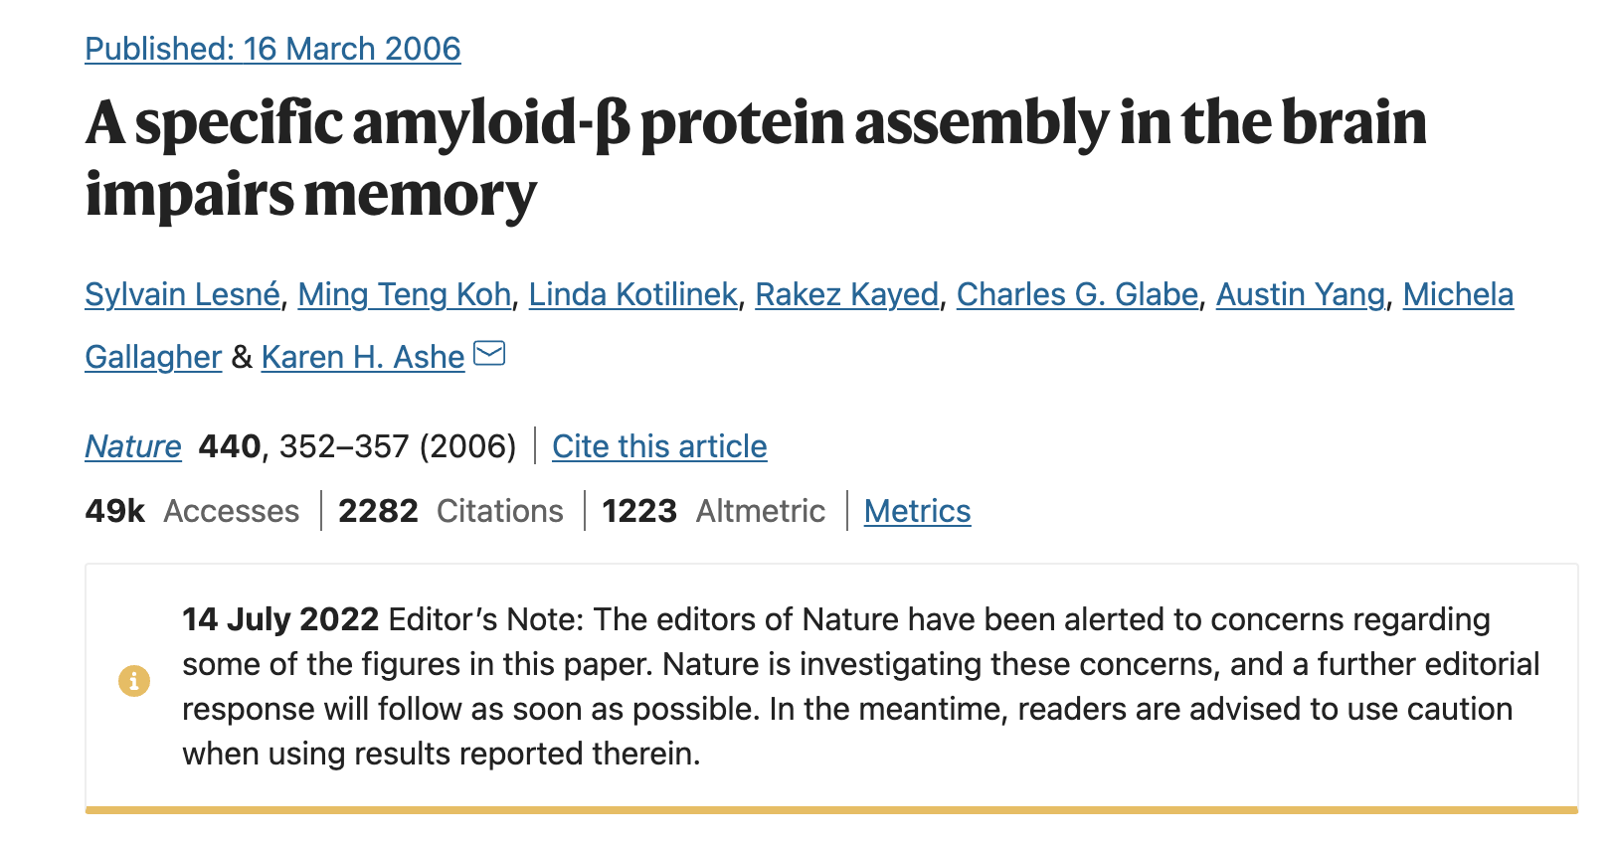
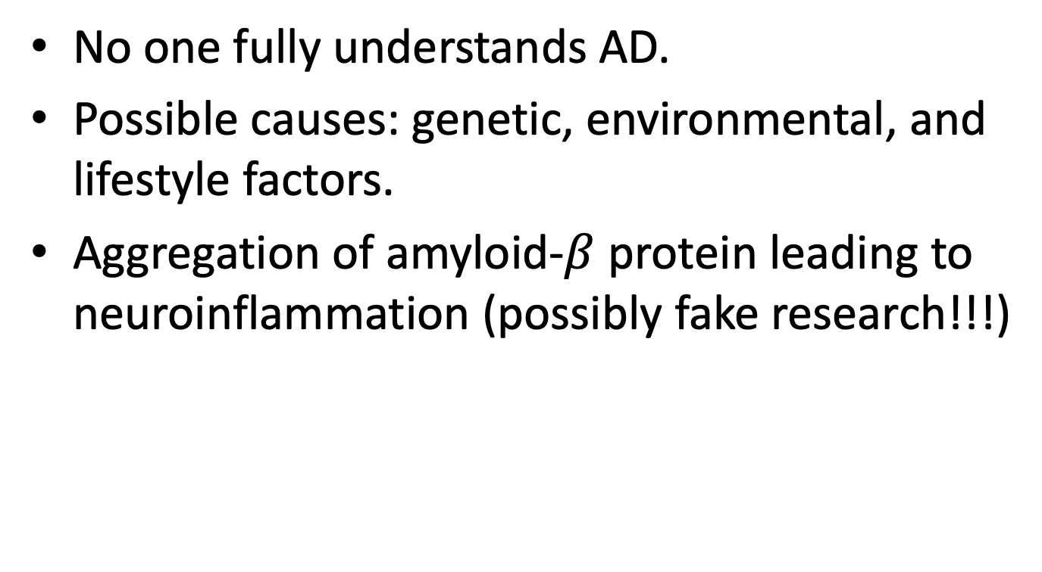
Causes of AD
No one fully understands AD.
Possible causes: genetic, environmental, and lifestyle factors.
Aggregation of amyloid-$β$ protein leading to neuroinflammation (possibly fake research!!!)

Slide 10
Outline
Background
Related Work
Method
Experiment
Conclusion

Slide 11
Existing Methods
Feature selection methods
Vector-based
Single-modality
PCA-based method
Feature projection
Less interpretability
Advanced models (CNNs, GCNs)
High accuracy
No interpretability

Slide 12
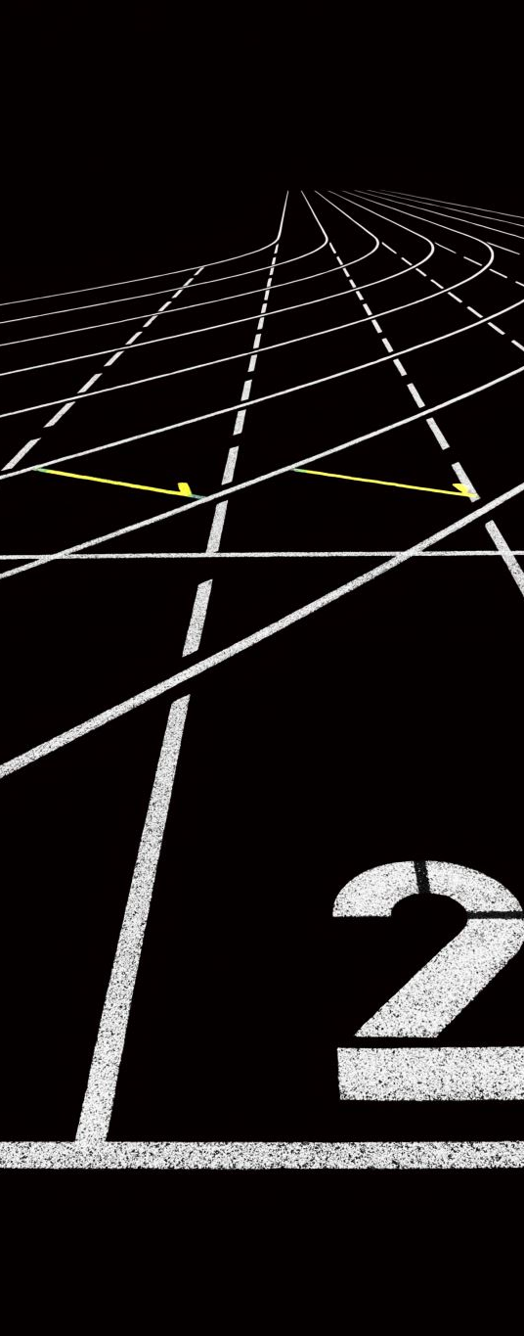
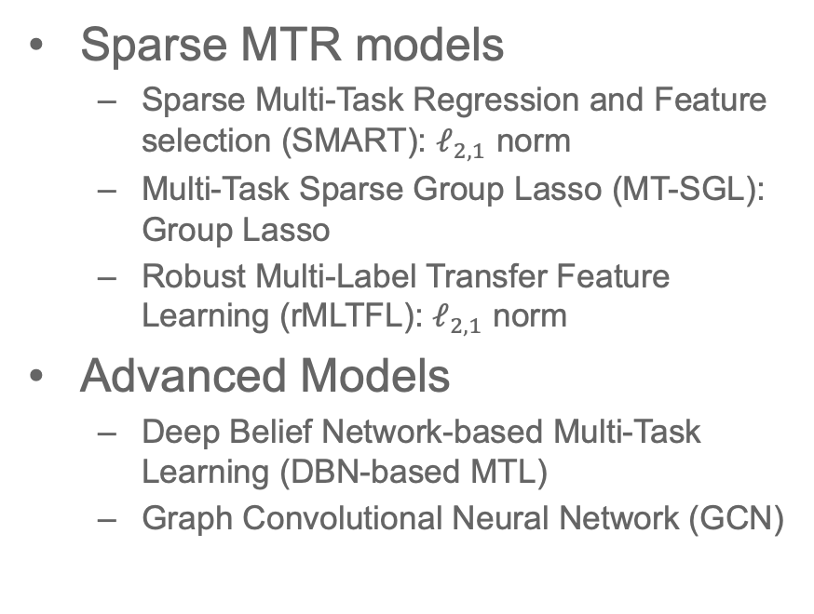
Baselines
Sparse MTR models
Sparse Multi-Task Regression and Feature selection (SMART): $ℓ_{2,1}$ norm
Multi-Task Sparse Group Lasso (MT-SGL): Group Lasso
Robust Multi-Label Transfer Feature Learning (rMLTFL): $ℓ_{2,1}$ norm
Advanced Models
Deep Belief Network-based Multi-Task Learning (DBN-based MTL)
Graph Convolutional Neural Network (GCN)

Slide 13
Materials
692 non-Hispanic Caucasian participants in the Alzheimer’s Disease Neuroimaging Initiative (ADNI) database
163 CN
73 SMC
214 EMCI
149 LMCI
93 AD patients
3 modalities of imaging data
structural Magnetic Resonance Imaging (VBM-MRI)
18 F-fluorodeoxyglucose Positron Emission Tomography (FDG-PET)
18 F-florbetapir PET (AV45-PET)

Slide 14
Outline
Background
Related Work
Method
Experiment
Conclusion

Slide 15
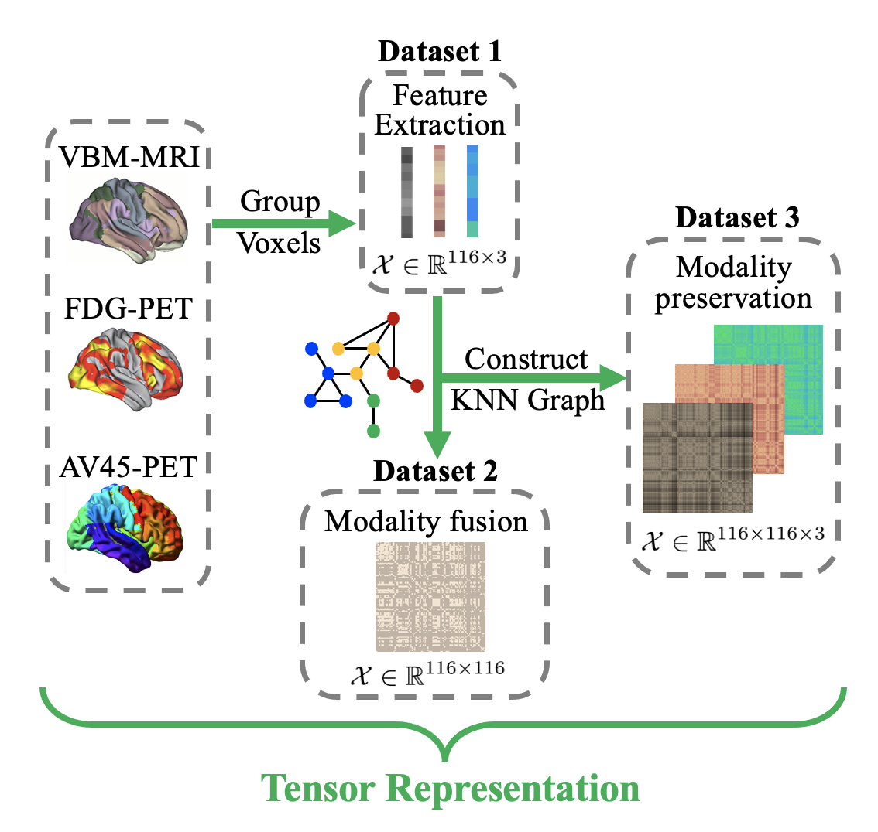
Data Preprocessing

Slide 16
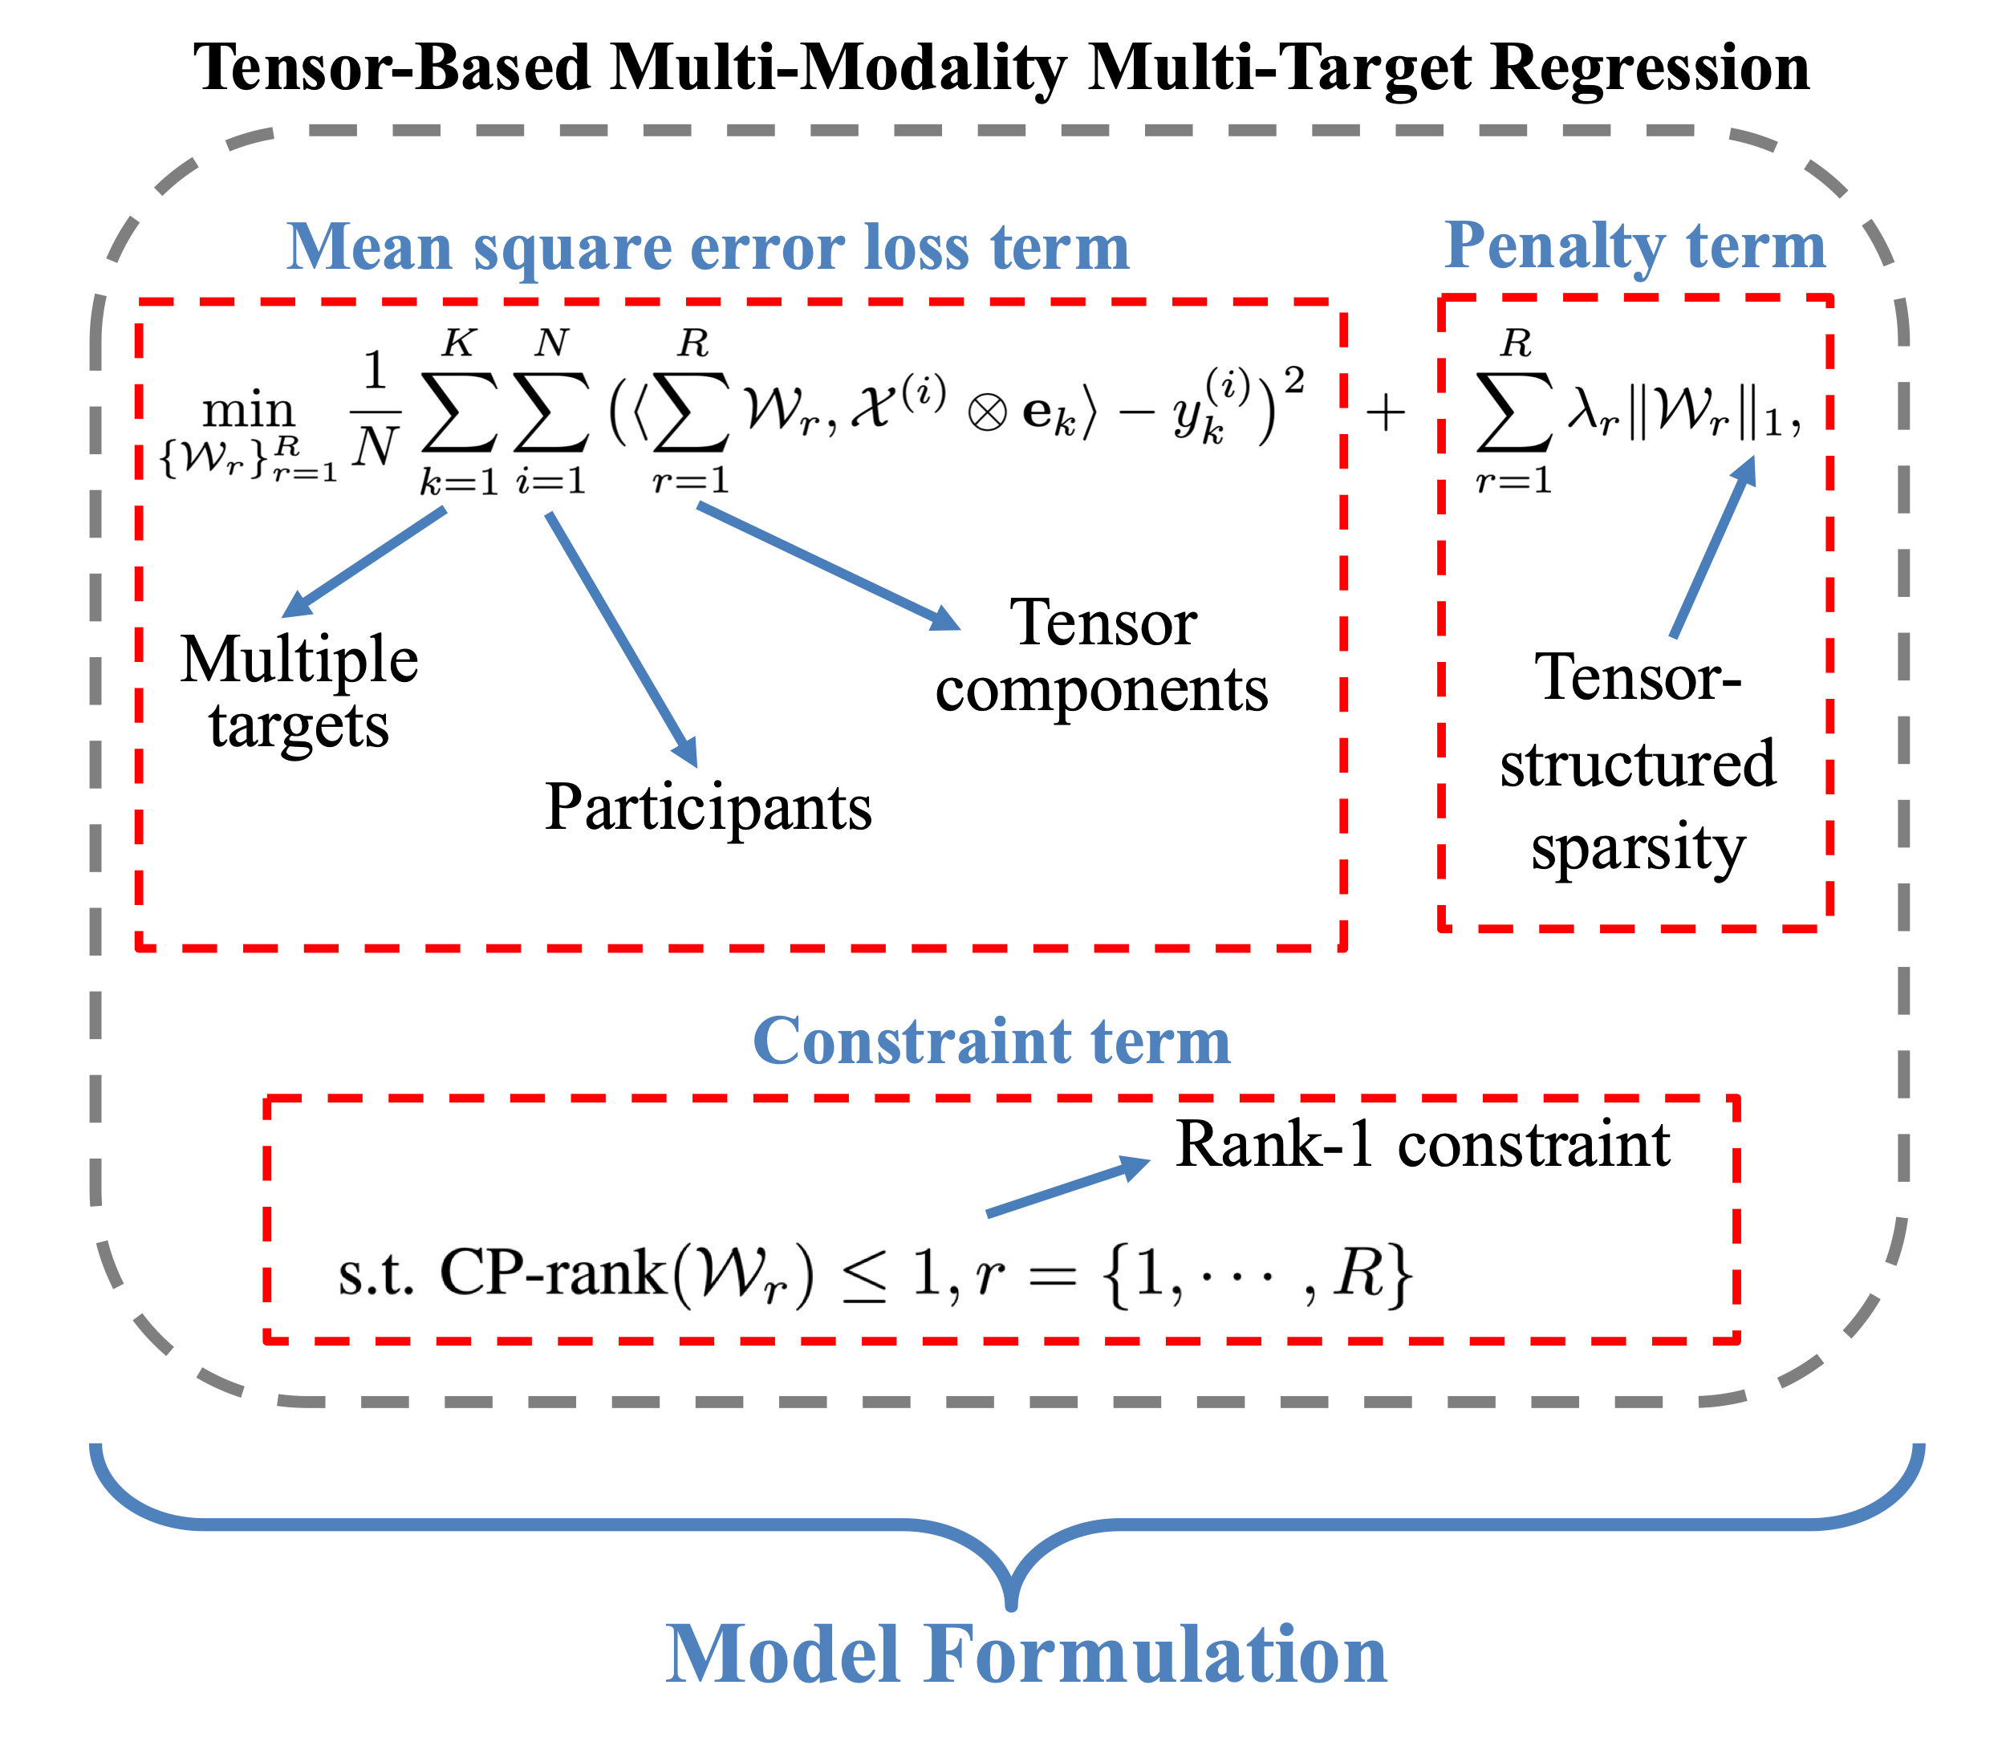
Formulation

Slide 17
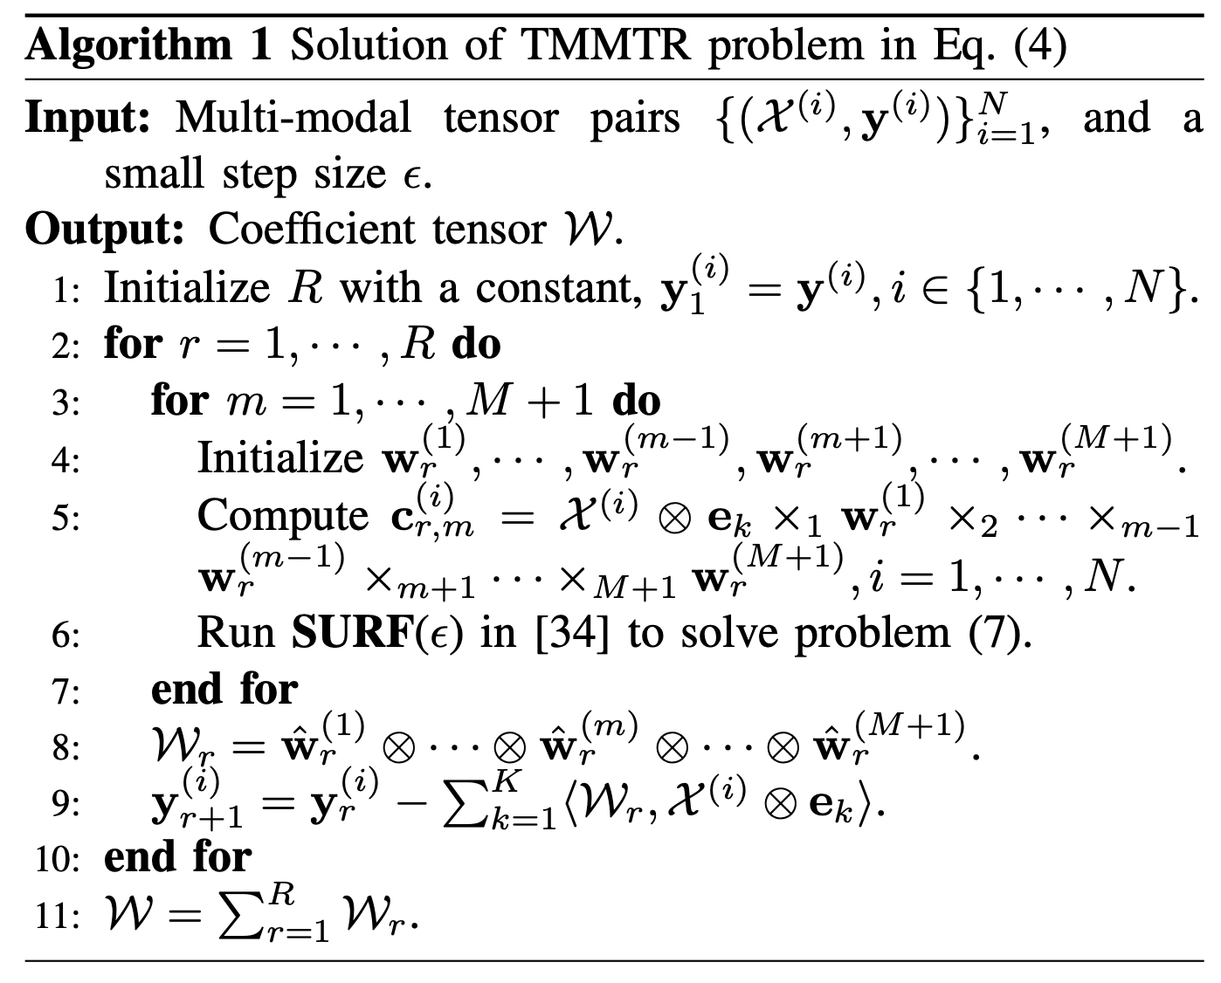
Algorithm

Slide 18
Outline
Background
Related Work
Method
Experiment
Conclusion

Slide 19
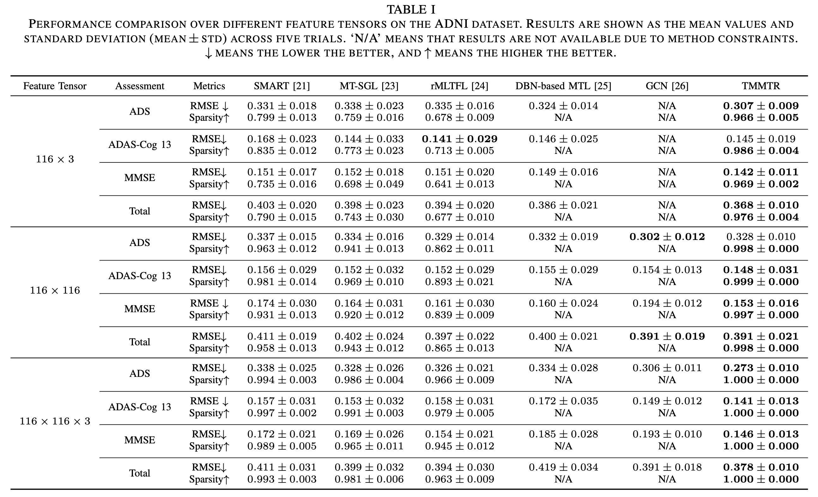
Performance Comparison

Slide 20
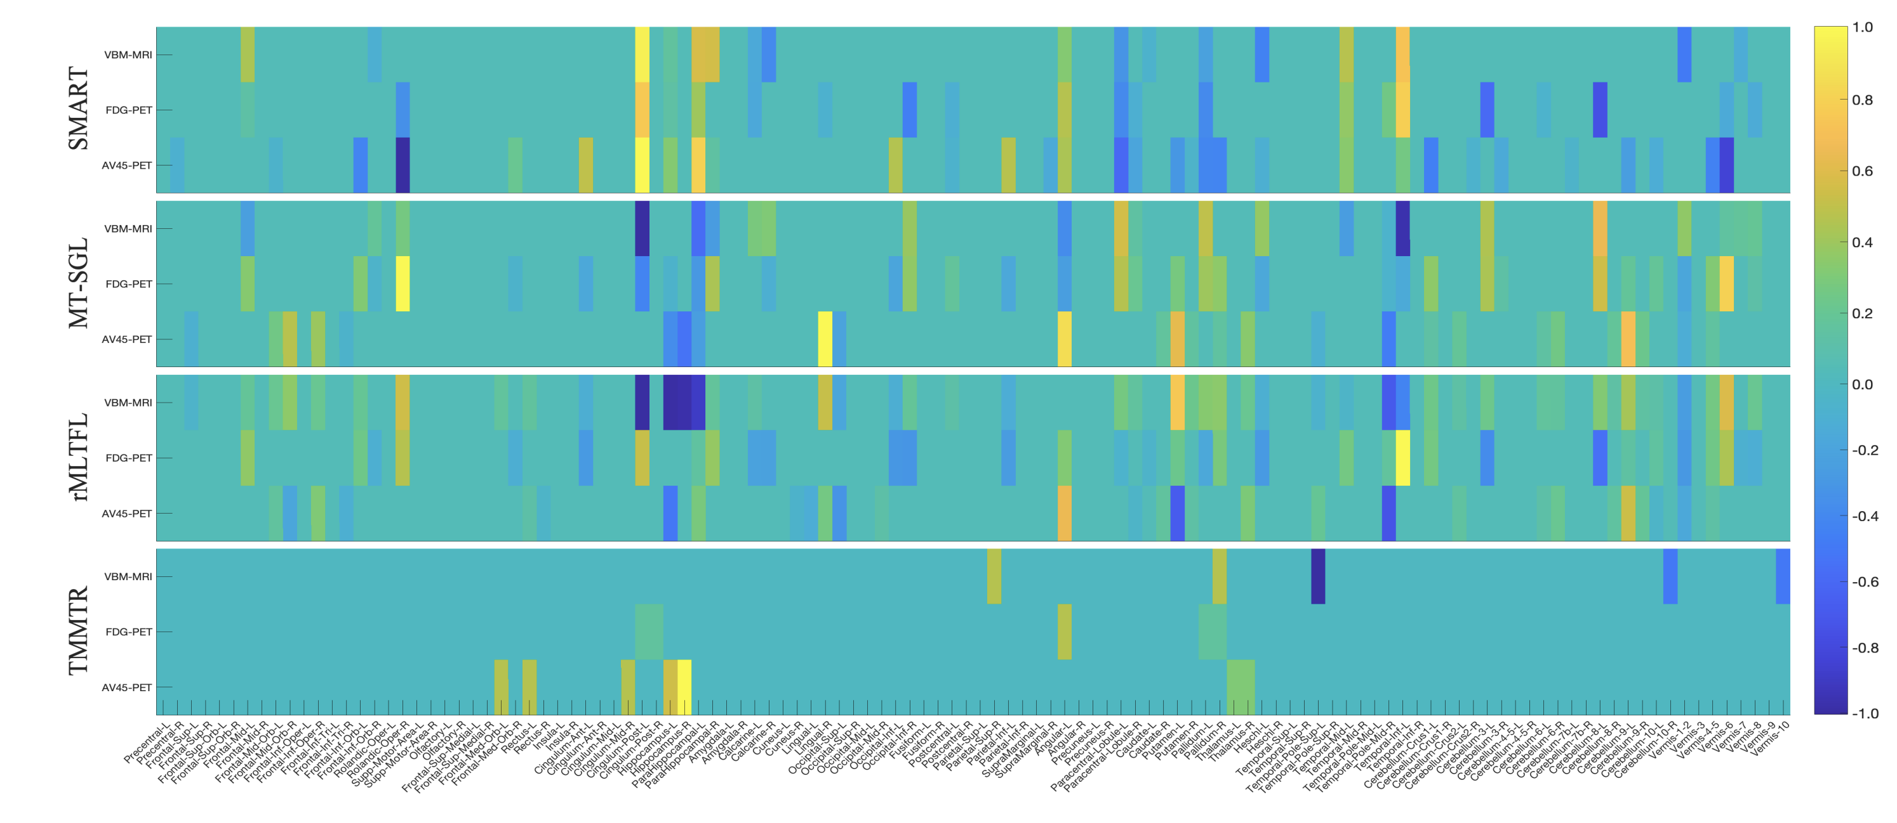
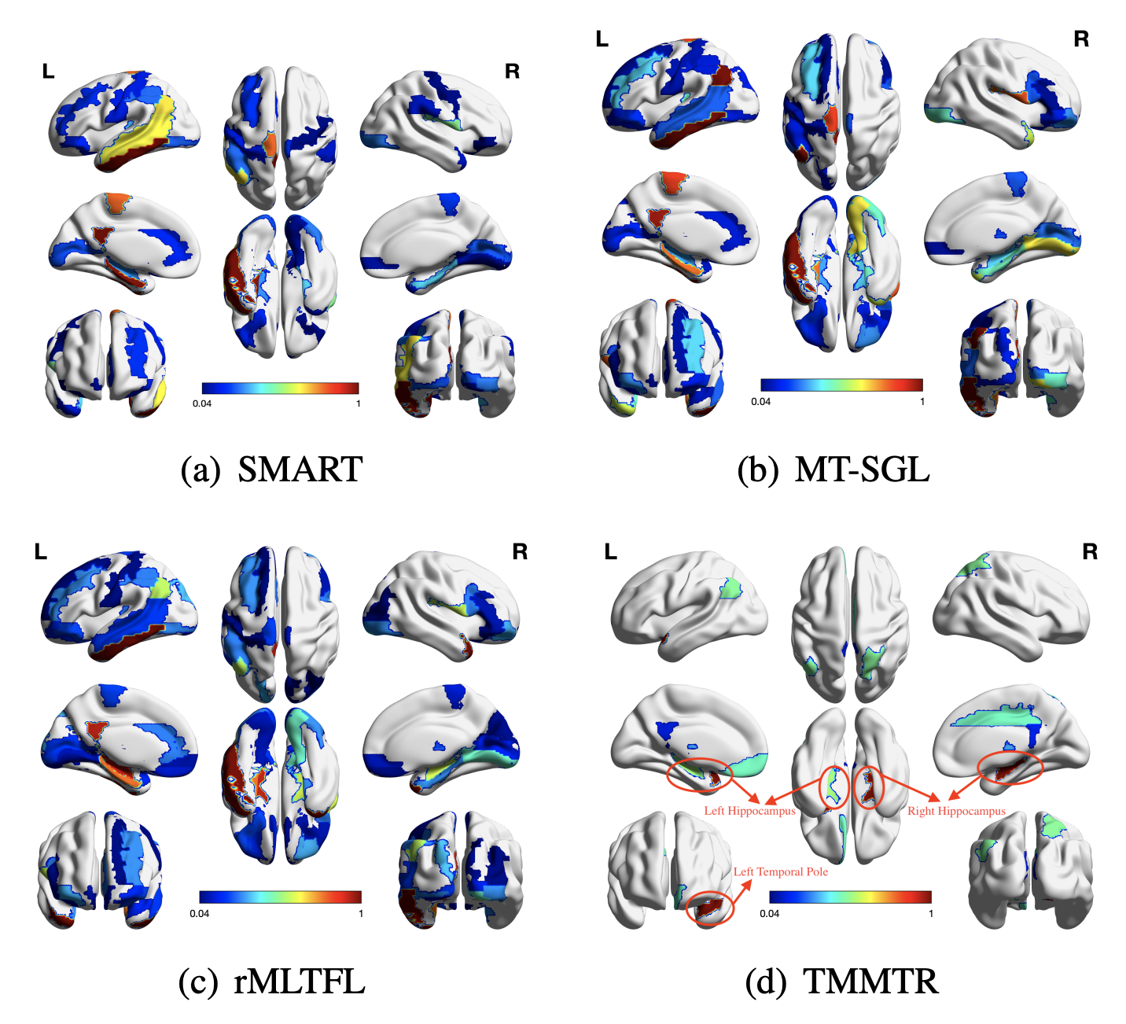
Visualization

Slide 21
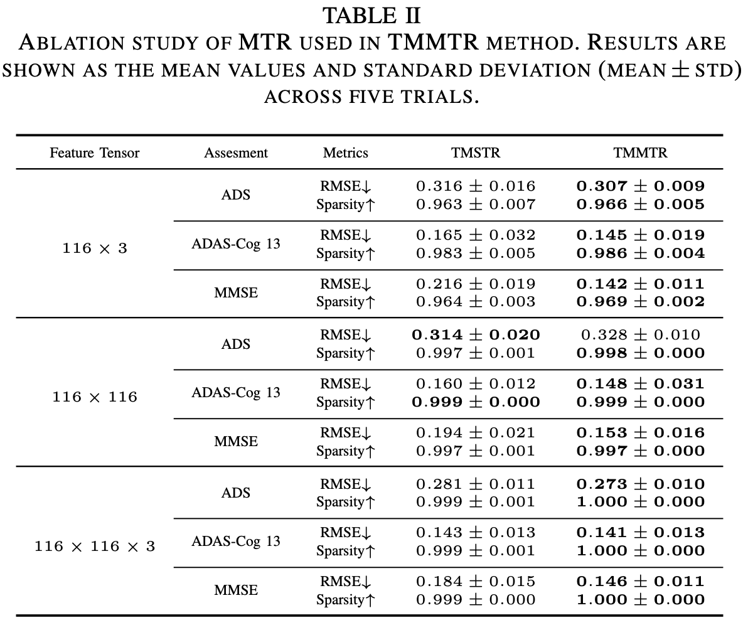
Ablation Study

Slide 22
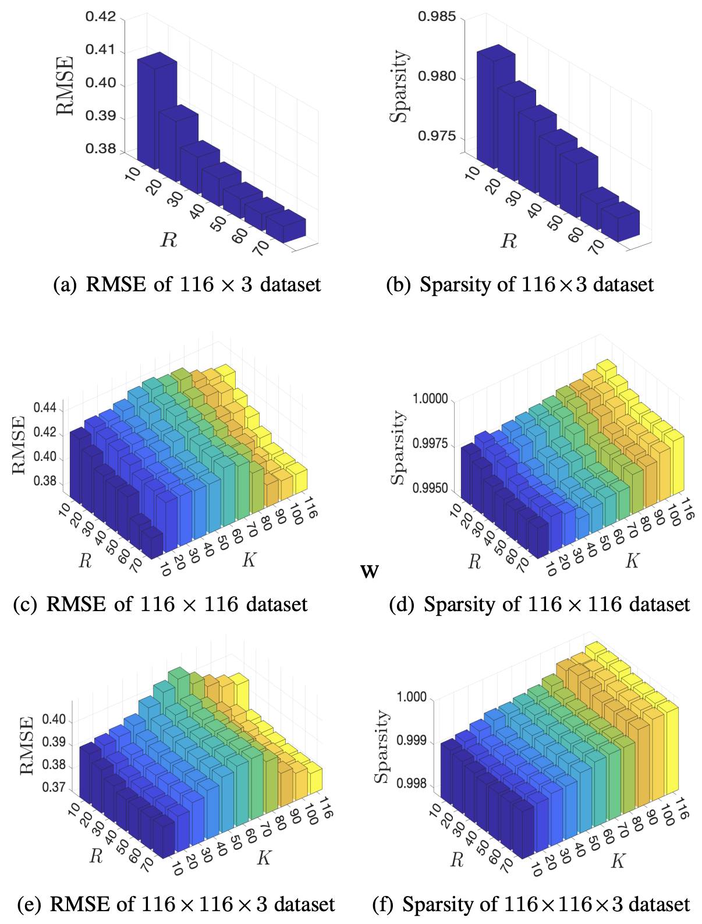
Hyperparameter Analysis

Slide 23
Outline
Background
Related Work
Method
Experiment
Conclusion

Slide 24
Conclusion
Tensor-structured information and Inter-target correlation are leveraged in TMMTR.
The Divide-and-conquer algorithm to solve TMMTR is effective and efficient.
Better performance with higher sparsity is realized in TMMTR.

